Slide 1
How Populations Evolve
AP Biology
Fall 2013 Ch. 13

Slide 2
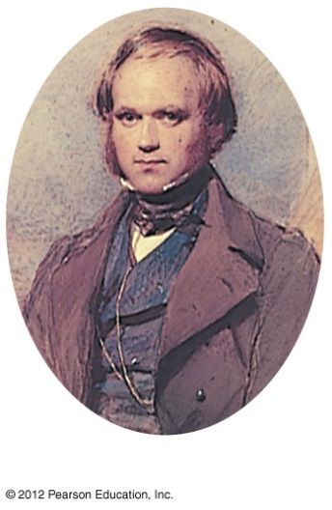
History of Evolution
A five-year voyage around the world helped Darwin make observations that would lead to his theory of evolution, the idea that Earth’s many species are descendants of ancestral species that were different from those living today.
In the century prior to Darwin, fossils suggested that species had indeed changed over time.
Some early Greek philosophers suggested that life might change gradually over time.
However, the Greek philosopher Aristotle viewed species as perfect and unchanging

Slide 3
History of Evolution
In the early 1800s, Jean Baptiste Lamarck suggested that life on Earth evolves, but by a different mechanism than that proposed by Darwin.
Lamarck proposed that
organisms evolve by the use and disuse of body parts and
these acquired characteristics are passed on to offspring
(our understanding of genetics refutes this idea but helped to set the stage for Darwin)

Slide 4
A sea voyage helped Darwin frame his theory of evolution
During Darwin’s round-the-world voyage on the HMS Beagle he was influenced by Lyell’s Principles of Geology, suggesting that natural forces
gradually changed Earth and
are still operating today.
Darwin came to realize that
the Earth was very old and
over time, present day species have arisen from ancestral species by natural processes.

Slide 5
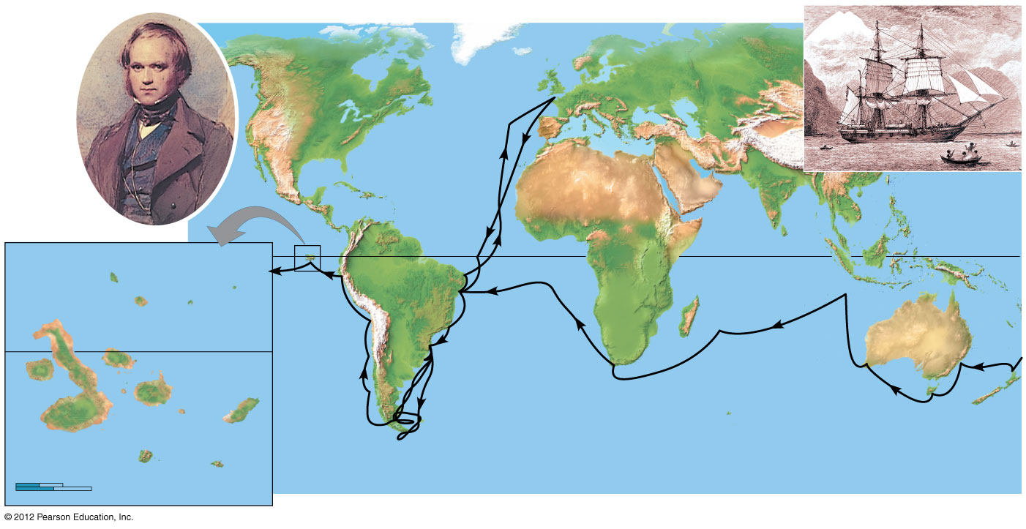
A sea voyage helped Darwin frame his theory of evolution
During his voyage, Darwin
collected thousands of plants and animals and
noted their characteristics that made them well suited to diverse environments.

Slide 6
A sea voyage helped Darwin frame his theory of evolution
In 1859, Darwin published On the Origin of Species by Means of Natural Selection,
presenting a strong, logical explanation of descent with modification, evolution by the mechanism of natural selection, and
noting that as organisms spread into various habitats over millions of years, they accumulated diverse adaptations that fit them to specific ways of life in these new environments.

Slide 7
Darwin proposed natural selection as the mechanism of evolution
Darwin recognized the connection between
natural selection and
the capacity of organisms to over reproduce.
Darwin had read an essay written in 1798 by the economist Thomas Malthus, who argued that human suffering was the consequence of human populations increasing faster than essential resources.

Slide 8
Darwin proposed natural selection as the mechanism of evolution
Darwin observed that organisms
vary in many traits and
produce more offspring than the environment can support.
Darwin reasoned that
organisms with traits that increase their chance of surviving and reproducing in their environment tend to leave more offspring than others and
this unequal reproduction will lead to the accumulation of favorable traits in a population over generations.

Slide 9
Darwin proposed natural selection as the mechanism of evolution
There are three key points about evolution by natural selection that clarify this process.
Individuals do not evolve: populations evolve.
Natural selection can amplify or diminish only heritable traits. Acquired characteristics cannot be passed on to offspring.
Evolution is not goal directed and does not lead to perfection. Favorable traits vary as environments change.

Slide 10
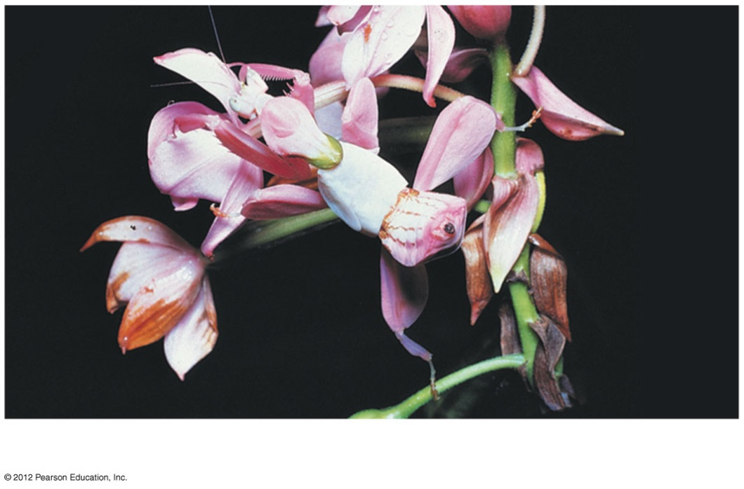
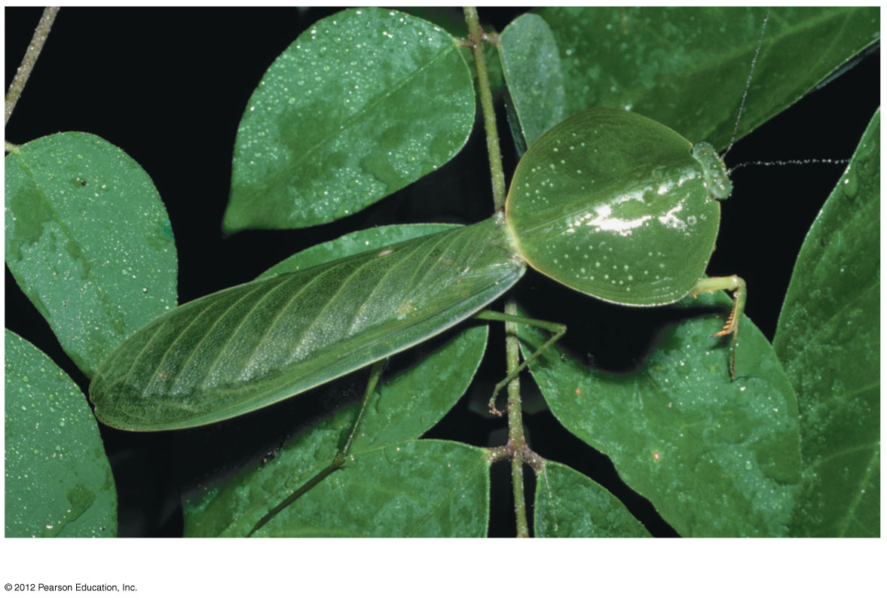
Scientists can observe natural selection in action
Camouflage adaptations in insects that evolved in different environments are examples of the results of natural selection.

Slide 11
Scientists can observe natural selection in action
Biologists have documented natural selection in action in thousands of scientific studies.
Rosemary and Peter Grant have worked on Darwin’s finches in the Galápagos for over 30 years. They found that
in wet years, small seeds are more abundant and small beaks are favored, but
in dry years, large strong beaks are favored because all seeds are in short supply and birds must eat more larger seeds.

Slide 12
Scientists can observe natural selection in action
Another example of natural selection in action is the evolution of pesticide resistance in insects.
A relatively small amount of a new pesticide may kill 99% of the insect pests, but subsequent sprayings are less effective.
Those insects that initially survived were fortunate enough to carry alleles that somehow enable them to resist the pesticide.
When these resistant insects reproduce, the percentage of the population resistant to the pesticide increases.

Slide 13
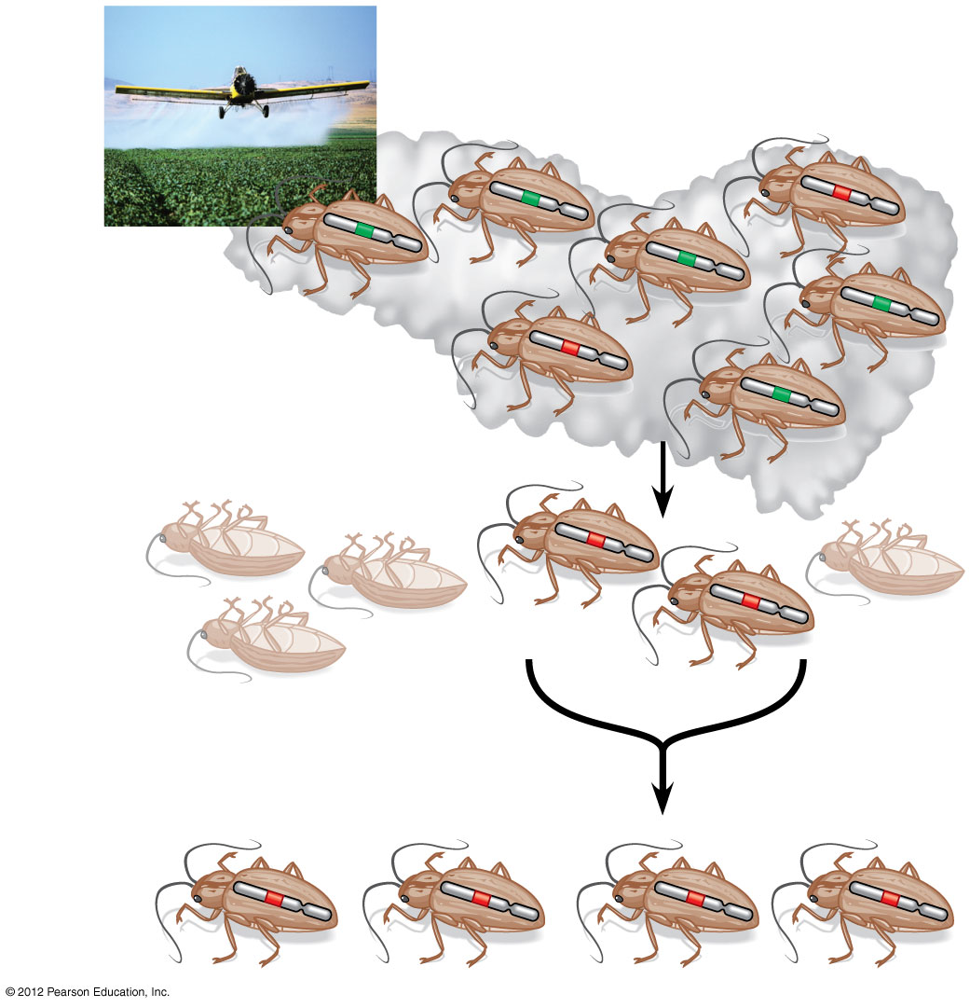

Slide 14
Scientists can observe natural selection in action
These examples of evolutionary adaptation highlight two important points about natural selection.
Natural selection is more of an editing process than a creative mechanism.
Natural selection is contingent on time and place, favoring those characteristics in a population that fit the current, local environment.

Slide 15
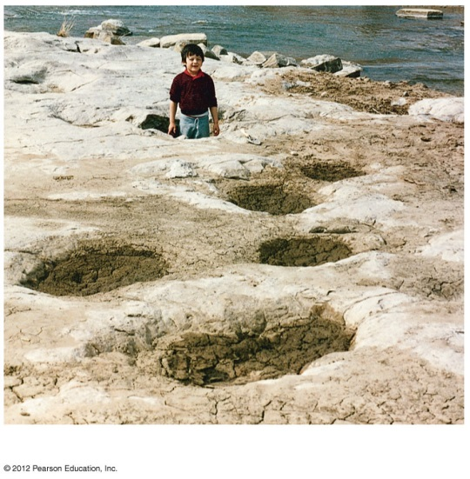
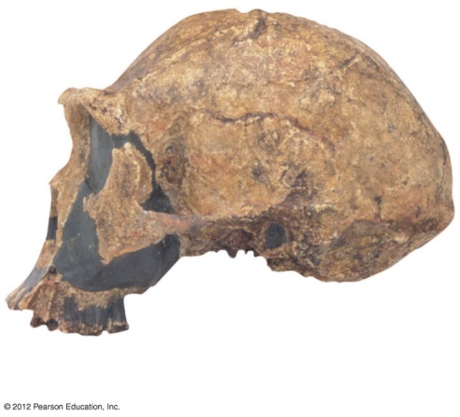
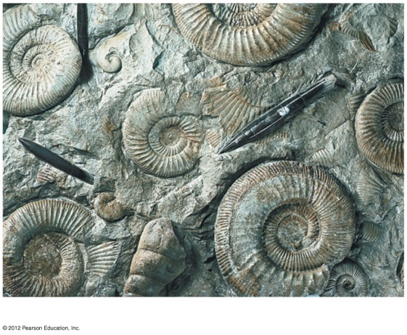
The study of fossils provides strong evidence for evolution
Fossils- the imprints or remains of organisms that lived in the past.
Darwin’s ideas about evolution also relied on the fossil record, the sequence in which fossils appear within strata (layers) of sedimentary rocks.
Paleontologists, scientists who study fossils, have found many types of fossils.
Skull of
Homo erectus
Ammonite casts
Dinosaur Tracks

Slide 16
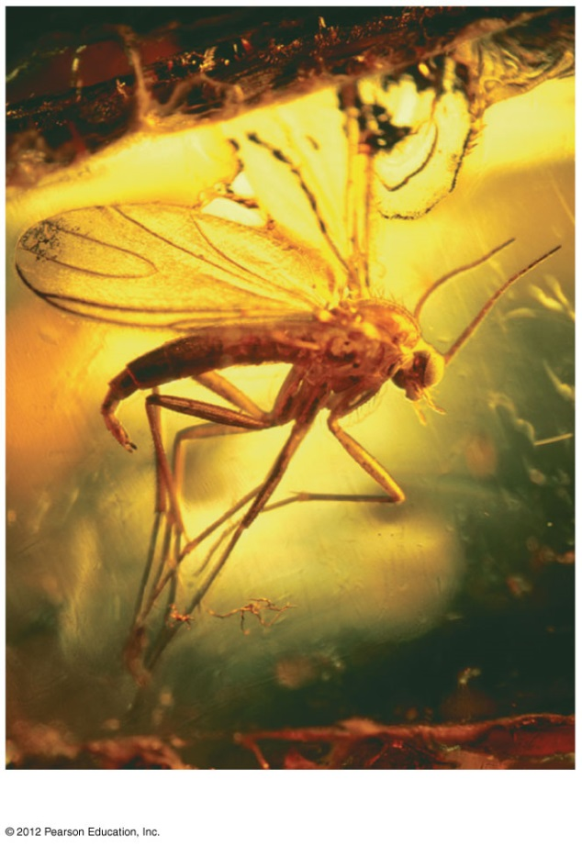
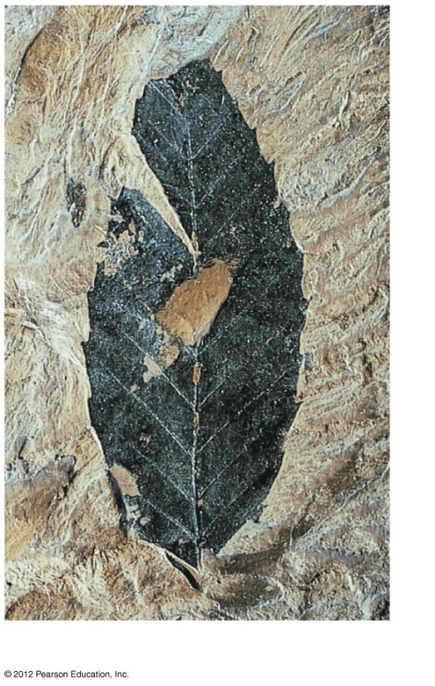
The study of fossils provides strong evidence for evolution
“Ice Man”
Insect in amber
Organic matter of leaf

Slide 17
The study of fossils provides strong evidence for evolution
The fossil record shows that organisms have evolved in a historical sequence.
The oldest known fossils, extending back about 3.5 billion years ago, are prokaryotes.
The oldest eukaryotic fossils are about a billion years younger.
Another billion years passed before we find fossils of multicellular eukaryotic life.

Slide 18
The study of fossils provides strong evidence for evolution
Many fossils link early extinct species with species living today.
A series of fossils traces the gradual modification of jaws and teeth in the evolution of mammals from a reptilian ancestor.
A series of fossils documents the evolution of whales from a group of land mammals.

Slide 19
The study of fossils provides strong evidence for evolution
Pakicetus (terrestrial)
Rodhocetus (predominantly aquatic)
Dorudon (fully aquatic)
Pelvis and
hind limb
Balaena (recent whale ancestor)
Pelvis and
hind limb

Slide 20
Many types of scientific evidence support the evolutionary view of life
Biogeography, the geographic distribution of species, suggested to Darwin that organisms evolve from common ancestors.
Darwin noted that Galápagos animals resembled species on the South American mainland more than they resembled animals on islands that were similar but much more distant.

Slide 21
Many types of scientific evidence support the evolutionary view of life
Comparative anatomy
is the comparison of body structures in different species,
was extensively cited by Darwin, and
illustrates that evolution is a remodeling process.
Homology is the similarity in characteristics that result from common ancestry.
Homologous structures have different functions but are structurally similar because of common ancestry.

Slide 22
Many types of scientific evidence support the evolutionary view of life
Humerus
Radius
Ulna
Carpals
Metacarpals
Phalanges
Human
Cat
Whale
Bat

Slide 23
Many types of scientific evidence support the evolutionary view of life
Comparative embryology
is the comparison of early stages of development among different organisms and
reveals homologies not visible in adult organisms.
For example, all vertebrate embryos have, at some point in their development,
a tail posterior to the anus and
pharyngeal throat pouches.
Vestigial structures are remnants of features that served important functions in an organism’s ancestors.

Slide 24
Many types of scientific evidence support the evolutionary view of life
Pharyngeal
pouches
Post-anal
tail
Chick
Embryo
Human
Embryo

Slide 25
Many types of scientific evidence support the evolutionary view of life
Advances in molecular biology reveal evolutionary relationships by comparing DNA and amino acid sequences between different organisms. These studies indicate that
all life-forms are related,
all life shares a common DNA code for the proteins found in living cells, and
humans and bacteria share homologous genes that have been inherited from a very distant common ancestor.

Slide 26
Homologies indicate patterns of descent that can be shown on an evolutionary tree
Darwin was the first to represent the history of life as a tree,
with multiple branchings from a common ancestral trunk
to the descendant species at the tips of the twigs.
Today, biologists
represent these patterns of descent with an evolutionary tree, but
often turn the trees sideways.

Slide 27
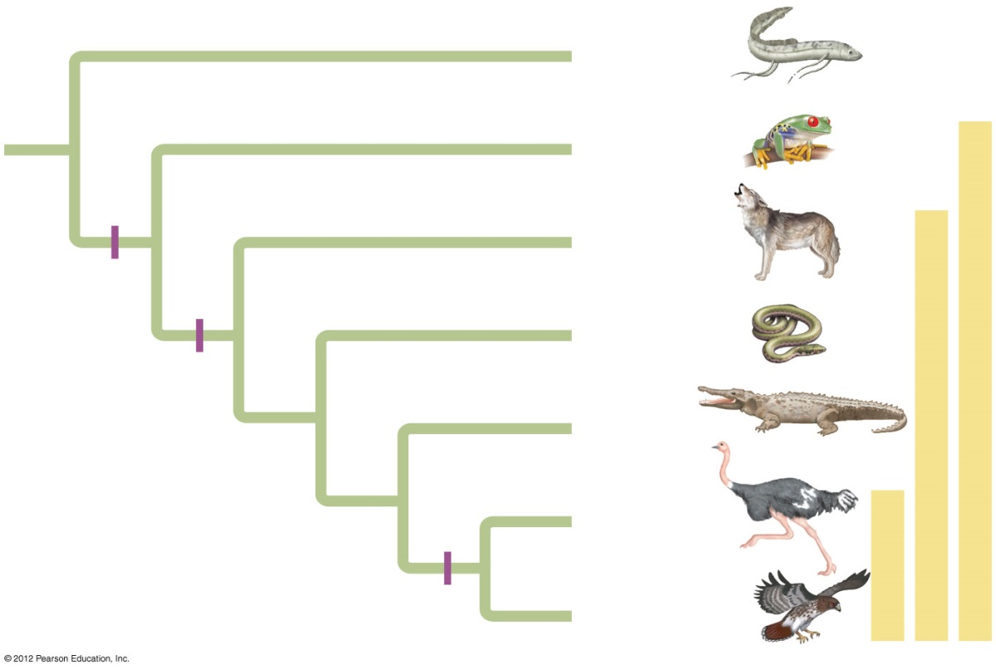
Homologies indicate patterns of descent that can be shown on an evolutionary tree
Homologous structures can be used to determine the branching sequence of an evolutionary tree. These homologies can include
anatomical structure and/or
molecular structure.
example of
an evolutionary tree.
Lungfishes
1
Amphibians
2
Mammals
Tetrapod
limbs
3
Lizards
and snakes
Amnion
4
Crocodiles
5
Ostriches
6
Feathers
Hawks &
Other Birds

Slide 28
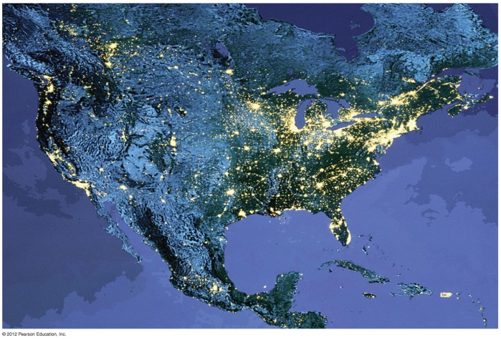
The Evolution of Populations
A population is
a group of individuals of the same species and
living in the same place at the same time.
Populations may be isolated from one another (with little interbreeding).
Individuals within populations may interbreed.
We can measure evolution as a change in heritable traits in a population over generations.

Slide 29
Evolution occurs within populations
A gene pool is the total collection of genes in a population at any one time.
Microevolution is a change in the relative frequencies of alleles in a gene pool over time.
Population genetics studies how populations change genetically over time.
The modern synthesis connects Darwin’s theory with population genetics.

Slide 30
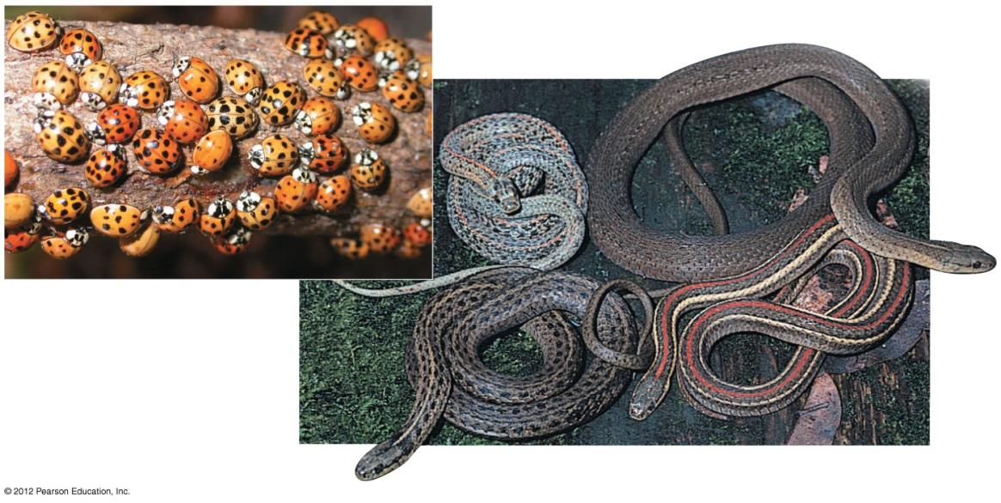
Mutation and sexual reproduction produce the genetic variation that makes evolution possible
Organisms typically show individual variation.
However, in The Origin of Species, Darwin could not explain
the cause of variation among individuals or
how variations were passed from parents to offspring.

Slide 31
Mutation and sexual reproduction produce the genetic variation that makes evolution possible
Mutations are
changes in the nucleotide sequence of DNA and
the ultimate source of new alleles.
On rare occasions, mutant alleles improve the adaptation of an individual to its environment.
This kind of effect is more likely when the environment is changing such that mutations that were once disadvantageous are favorable under new conditions.
The evolution of DDT-resistant houseflies is such an example.

Slide 32
Mutation and sexual reproduction produce the genetic variation that makes evolution possible
Chromosomal duplication is an important source of genetic variation.
If a gene is duplicated, the new copy can undergo mutation without affecting the function of the original copy.
For example, an early ancestor of mammals had a single gene for an olfactory receptor. That gene has been duplicated many times, and mice now have 1,300 different olfactory receptor genes.

Slide 33
Mutation and sexual reproduction produce the genetic variation that makes evolution possible
Sexual reproduction shuffles alleles to produce new combinations in three ways.
Homologous chromosomes sort independently as they separate during anaphase I of meiosis.
During prophase I of meiosis, pairs of homologous chromosomes cross over and exchange genes.
Further variation arises when sperm randomly unite with eggs in fertilization.
Animation: Genetic Variation from Sexual Recombination
13_08SexualRecombination_A.html

Slide 34
The Hardy-Weinberg equation can test whether a population is evolving
Sexual reproduction alone does not lead to evolutionary change in a population.
Although alleles are shuffled, the frequency of alleles and genotypes in the population does not change.
Similarly, if you shuffle a deck of cards, you will deal out different hands, but the cards and suits in the deck do not change.
The Hardy-Weinberg principle states that
within a sexually reproducing, diploid population,
allele and genotype frequencies will remain in equilibrium,
unless outside forces act to change those frequencies.

Slide 35
The Hardy-Weinberg equation can test whether a population is evolving
For a population to remain in Hardy-Weinberg equilibrium for a specific trait, it must satisfy five conditions. There must be
a very large population,
no gene flow between populations,
no mutations,
random mating, and
no natural selection.

Slide 36
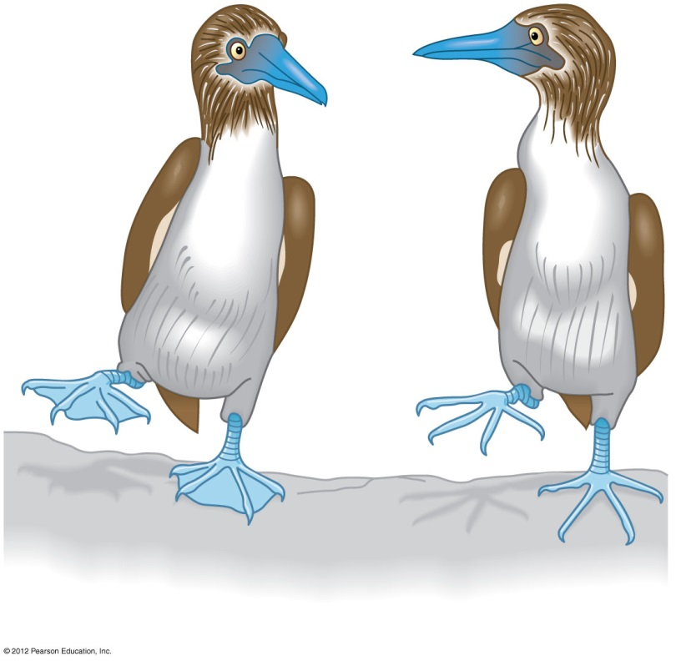
The Hardy-Weinberg equation can test whether a population is evolving
Imagine that there are two alleles in a blue-footed booby population, W and w.
Uppercase W is a dominant allele for a nonwebbed booby foot.
Lowercase w is a recessive allele for a webbed booby foot.
Webbing
No webbing

Slide 37
The Hardy-Weinberg equation can test whether a population is evolving
Consider the gene pool of a population of 500 boobies.
320 (64%) are homozygous dominant (WW).
160 (32%) are heterozygous (Ww).
20 (4%) are homozygous recessive (ww).
p = 80% of alleles in the booby population are W.
q = 20% of alleles in the booby population are w.

Slide 38
The Hardy-Weinberg equation can test whether a population is evolving
Phenotypes
Genotypes
WW
Ww
ww
Number of animals
(total = 500)
320
160
20
Genotype frequencies
320
=
0.64
160
=
0.32
20
=
0.04
500
500
500
Number of alleles
in gene pool
(total = 1,000)
640 W
160 W + 160 w
40 w
Allele frequencies
800
=
0.8 W
200
=
0.2 w
1,000
1,000

Slide 39
The Hardy-Weinberg equation can test whether a population is evolving
The frequency of all three genotypes must be 100% or 1.0.
p² + 2pq + q² = 100% = 1.0
homozygous dominant (p²) + heterozygous (2pq) + homozygous recessive (q²) = 100%

Slide 40
The Hardy-Weinberg equation can test whether a population is evolving
What about the next generation of boobies?
The probability that a booby sperm or egg carries W = 0.8 or 80%.
The probability that a sperm or egg carries w = 0.2 or 20%.
The genotype frequencies will remain constant generation after generation unless something acts to change the gene pool.

Slide 41
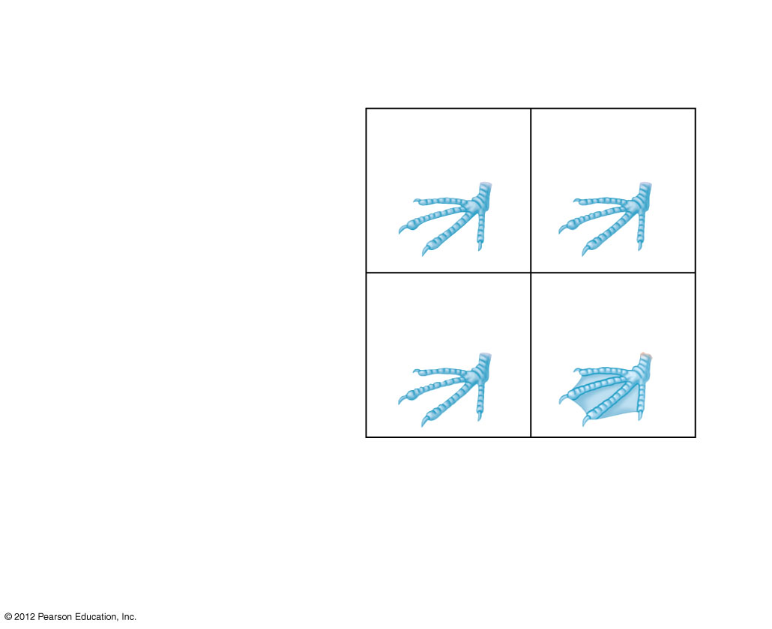
Gametes reflect allele
frequencies of parental
gene pool.
Sperm
W
w
p = 0.8
q = 0.2
WW
Ww
p² = 0.64
pq = 0.16
W
p = 0.8
Eggs
wW
ww
w
qp = 0.16
q² = 0.04
q = 0.2
Next generation:
Genotype frequencies
0.64 WW
0.32 Ww
0.04 ww
Allele frequencies
0.8 W
0.2 w

Slide 42
The Hardy-Weinberg equation can test whether a population is evolving
How could the Hardy-Weinberg equilibrium be disrupted?
Small populations could increase the chances that allele frequencies will fluctuate by chance.
Individuals moving in or out of populations add or remove alleles.
Mutations can change or delete alleles.
Preferential mating can change the frequencies of homozygous and heterozygous genotypes.
Unequal survival and reproductive success of individuals (natural selection) can alter allele frequencies.

Slide 43
CONNECTION: The Hardy-Weinberg equation is useful in public health science
Public health scientists use the Hardy-Weinberg equation to estimate frequencies of disease-causing alleles in the human population.
One out of 10,000 babies born in the United States has phenylketonuria (PKU), an inherited inability to break down the amino acid phenylalanine.
Individuals with PKU must strictly limit the intake of foods with phenylalanine.

Slide 44
CONNECTION: The Hardy-Weinberg equation is useful in public health science
INGREDIENTS: SORBITOL,
MAGNESIUM STEARATE,
ARTIFICIAL FLAVOR,
ASPARTAME† (SWEETENER),
ARTIFICIAL COLOR
(YELLOW 5 LAKE, BLUE 1
LAKE), ZINC GLUCONATE.
†PHENYLKETONURICS:
CONTAINS PHENYLALANINE

Slide 45
CONNECTION: The Hardy-Weinberg equation is useful in public health science
PKU is a recessive allele.
The frequency of individuals born with PKU corresponds to the q² term in the Hardy-Weinberg equation and would equal 0.0001.
The value of q is 0.01.
The frequency of the dominant allele would equal 1 – q, or 0.99.
The frequency of carriers
= 2pq
= 2 × 0.99 × 0.01 = 0.0198 = 1.98% of the U.S. population.

Slide 46
MECHANISMS OF MICROEVOLUTION
If the five conditions for the Hardy-Weinberg equilibrium are not met in a population, the population’s gene pool may change. However,
mutations are rare and random and have little effect on the gene pool, and
nonrandom mating may change genotype frequencies but usually has little impact on allele frequencies.

Slide 47
Natural selection, genetic drift, and gene flow can cause microevolution
The three main causes of evolutionary change are
natural selection,
genetic drift, and
gene flow.

Slide 48
Natural selection, genetic drift, and gene flow can cause microevolution
1. Natural selection
If individuals differ in their survival and reproductive success, natural selection will alter allele frequencies.
Consider the imaginary booby population. Webbed boobies (ww) might
be more successful at swimming,
capture more fish,
produce more offspring, and
increase the frequency of the w allele in the gene pool.

Slide 49
Natural selection, genetic drift, and gene flow can cause microevolution
2. Genetic drift
Genetic drift is a change in the gene pool of a population due to chance.
In a small population, chance events may lead to the loss of genetic diversity.

Slide 50
Natural selection, genetic drift, and gene flow can cause microevolution
2. Genetic drift, continued
The bottleneck effect leads to a loss of genetic diversity when a population is greatly reduced.
For example, the greater prairie chicken once numbered in the millions, but was reduced to about 50 birds in Illinois by 1993.
A survey comparing the DNA of the surviving chickens with DNA extracted from museum specimens dating back to the 1930s showed a loss of 30% of the alleles.

Slide 51
Natural selection, genetic drift, and gene flow can cause microevolution
Original
population
Bottlenecking
event
Surviving
population

Slide 52
Natural selection, genetic drift, and gene flow can cause microevolution
2. Genetic drift, continued
Genetic drift also results from the founder effect, when a few individuals colonize a new habitat.
A small group cannot adequately represent the genetic diversity in the ancestral population.
The frequency of alleles will therefore be different between the old and new populations.

Slide 53
Natural selection, genetic drift, and gene flow can cause microevolution
Gene flow
is the movement of individuals or gametes/spores between populations and
can alter allele frequencies in a population.
To counteract the lack of genetic diversity in the remaining Illinois greater prairie chickens,
researchers added 271 birds from neighboring states to the Illinois populations, which
successfully introduced new alleles.

Slide 54
Natural selection, genetic drift, and gene flow can cause microevolution
Genetic drift, gene flow, and mutations could each result in microevolution, but only by chance could these events improve a population’s fit to its environment.
Natural selection is a blend of
chance and
sorting.
Because of this sorting, only natural selection consistently leads to adaptive evolution.

Slide 55
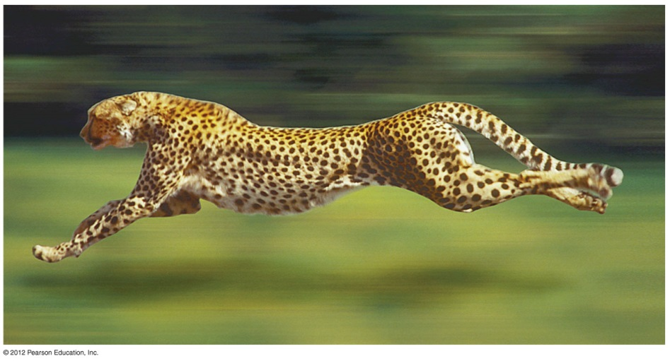
Natural selection, genetic drift, and gene flow can cause microevolution
An individual’s relative fitness is the contribution it makes to the gene pool of the next generation relative to the contribution of other individuals.
The fittest individuals are those that
produce the largest number of viable, fertile offspring and
pass on the most genes to the next generation.

Slide 56
Natural selection can alter variation in a population in three ways
Natural selection can affect the distribution of phenotypes in a population.
Stabilizing selection favors intermediate phenotypes, acting against extreme phenotypes.
Directional selection acts against individuals at one of the phenotypic extremes.
Disruptive selection favors individuals at both extremes of the phenotypic range.

Slide 57
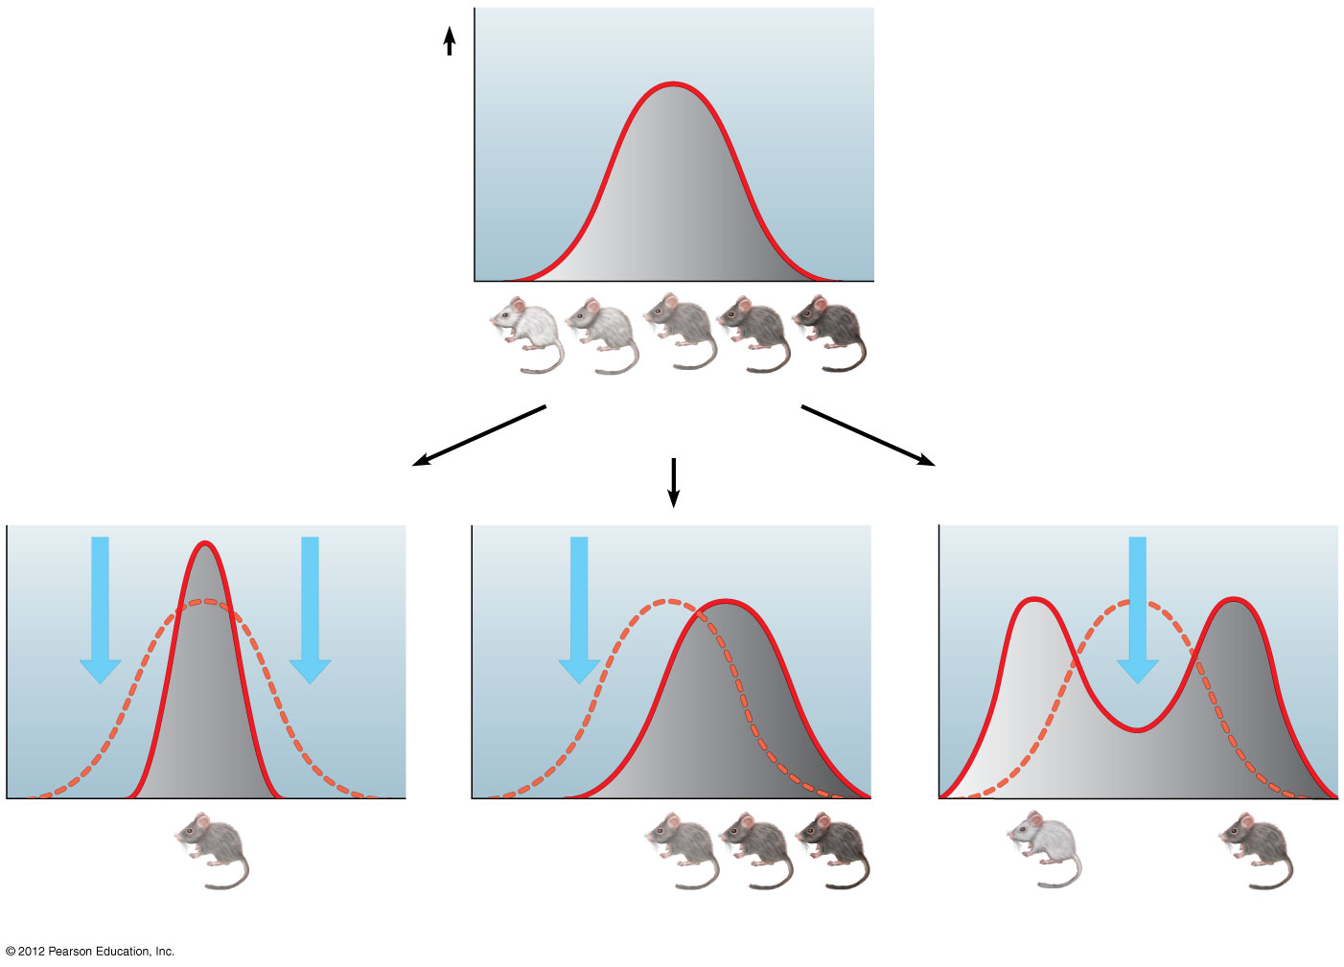
Figure 13.13
Original
population
Original
population
Frequency of
individuals
Frequency of
individuals
Original
population
Evolved
population
Phenotypes
(fur color)
Original
population
Evolved
population
Phenotypes
(fur color)
Stabilizing selection
Directional selection
Disruptive selection
Stabilizing selection
Directional selection
Disruptive selection
Notes:
57
Figure 13.13 Three possible effects of natural selection on a phenotypic character

Slide 58
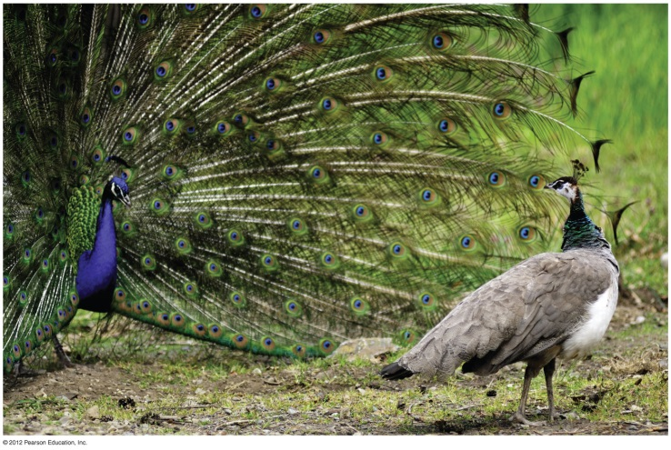
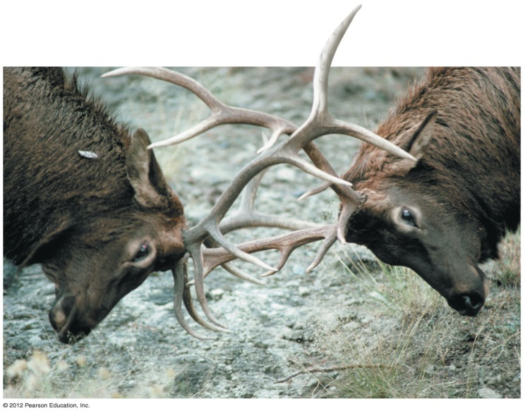
Sexual selection may lead to phenotypic differences between males and females
Sexual selection
is a form of natural selection
in which individuals with certain characteristics are more likely than other individuals to obtain mates.
In many animal species, males and females show distinctly different appearances, called sexual dimorphism.
Intrasexual selection (within the same sex) involves competition for mates, usually by males.

Slide 59
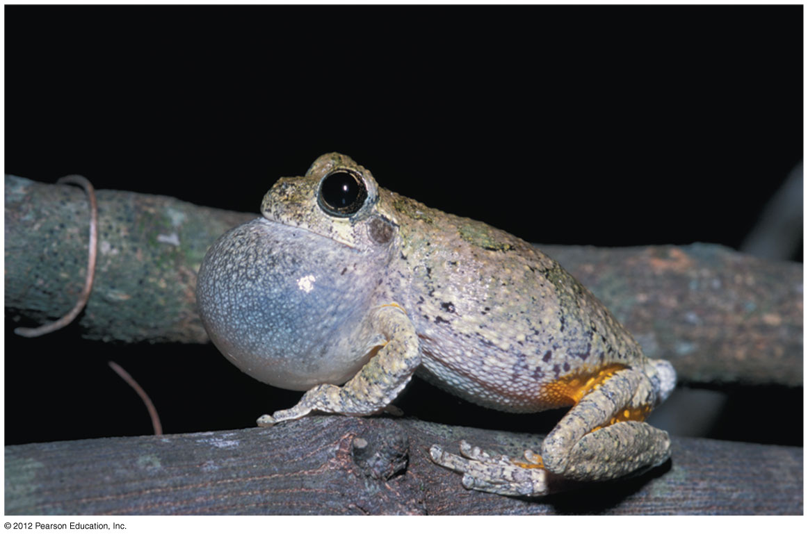
Sexual selection may lead to phenotypic differences between males and females
In intersexual selection (between sexes) or mate choice, individuals of one sex (usually females)
are choosy in picking their mates and
often select flashy or colorful mates.

Slide 60
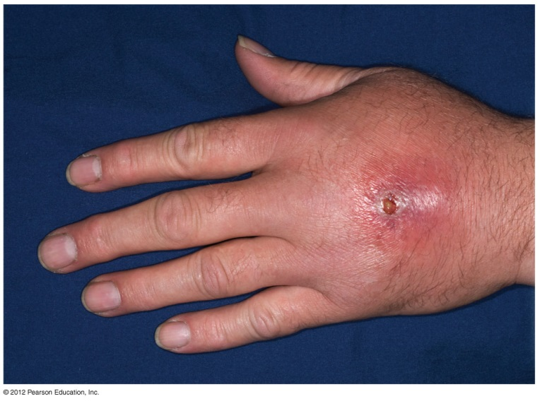
EVOLUTION CONNECTION: The evolution of antibiotic resistance in bacteria is a serious public health concern
The excessive use of antibiotics is leading to the evolution of antibiotic-resistant bacteria.
As a result, natural selection is favoring bacteria that are naturally resistant to antibiotics.
Natural selection for antibiotic resistance is particularly strong in hospitals.
Methicillin-resistant (MRSA) bacteria can cause “flesh-eating disease” and potentially fatal infections.

Slide 61
Diploidy and balancing selection preserve genetic variation
What prevents natural selection from eliminating unfavorable genotypes?
In diploid organisms, recessive alleles are usually not subject to natural selection in heterozygotes.
Balancing selection maintains stable frequencies of two or more phenotypes in a population.
In heterozygote advantage, heterozygotes have greater reproductive success than homozygotes.
Frequency-dependent selection is a type of balancing selection that maintains two different phenotypes in a population.

Slide 62
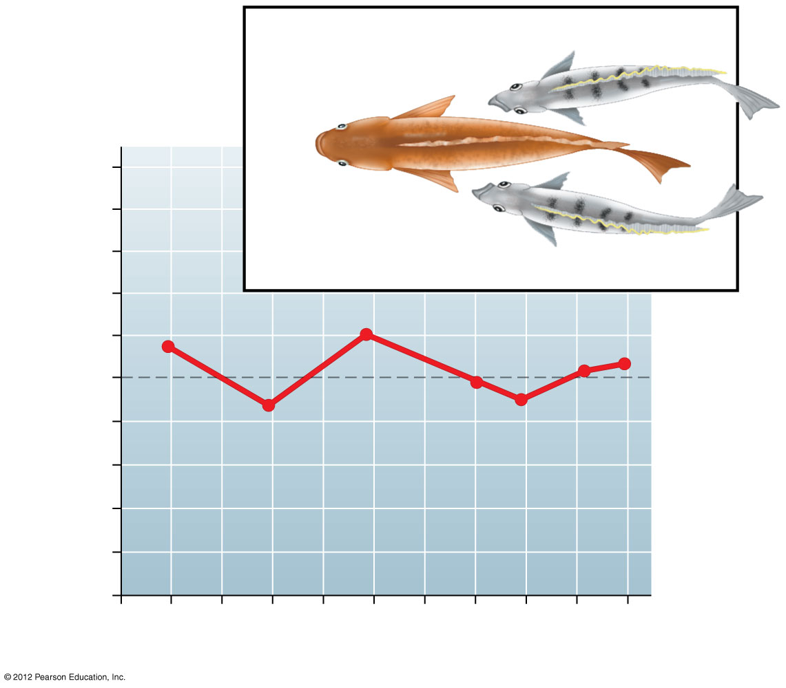
“Left-mouthed”
1.0
“Right-mouthed”
Frequency of
“left-mouthed” individuals
0.5
0
1981
ʼ82
ʼ83
ʼ84
ʼ85
ʼ86
ʼ87
ʼ88
ʼ89
ʼ90
Sample year

Slide 63
Natural selection cannot fashion perfect organisms
The evolution of organisms is constrained.
1. Selection can act only on existing variations. New, advantageous alleles do not arise on demand.
2. Evolution is limited by historical constraints. Evolution co-opts existing structures and adapts them to new situations.
3. Adaptations are often compromises. The same structure often performs many functions.
4. Chance, natural selection, and the environment interact. Environments often change unpredictably.

Slide 64
You should now be able to
Explain how Darwin’s voyage on the Beagle influenced his thinking.
Explain how the work of Thomas Malthus and the process of artificial selection influenced Darwin’s development of the idea of natural selection.
Describe Darwin’s observations and inferences in developing the concept of natural selection.
Explain why individuals cannot evolve and why evolution does not lead to perfectly adapted organisms.

Slide 65
You should now be able to
Describe two examples of natural selection known to occur in nature.
Explain how fossils form, noting examples of each process.
Explain how the fossil record, biogeography, comparative anatomy, and molecular biology support evolution.
Explain how evolutionary trees are constructed and used to represent ancestral relationships.
Define the gene pool, a population, and microevolution.

Slide 66
You should now be able to
Explain how mutation and sexual reproduction produce genetic variation.
Explain why prokaryotes can evolve more quickly than eukaryotes.
Describe the five conditions required for the Hardy-Weinberg equilibrium.
Explain why the Hardy-Weinberg equilibrium is significant to understanding the evolution of natural populations and to public health science.

Slide 67
You should now be able to
Define genetic drift and gene flow. Explain how the bottleneck effect and the founder effect influence microevolution.
Distinguish between stabilizing selection, directional selection, and disruptive selection. Describe an example of each.
Define and compare intrasexual selection and intersexual selection.
Explain how antibiotic resistance has evolved.
Explain why natural selection cannot produce perfection.

Slide 68
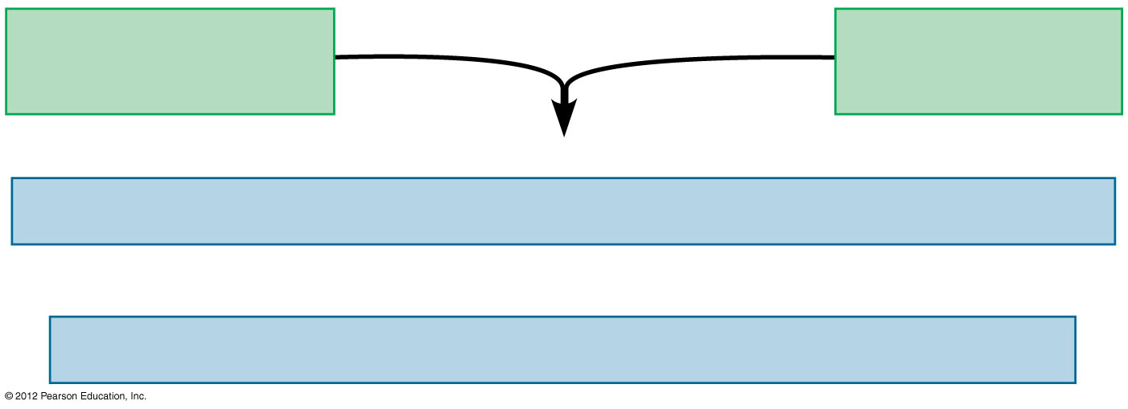
Observations
Heritable variations
in individuals
Overproduction
of offspring
Inferences
Individuals well-suited to the environment tend to leave more offspring.
and
Over time, favorable traits accumulate in the population.

Slide 69
Allele frequencies
p
+
q
=
1
Genotype frequencies
p²
+
2pq
+
q²
=
1
Dominant
homozygotes
Heterozygotes
Recessive
homozygotes

Slide 70
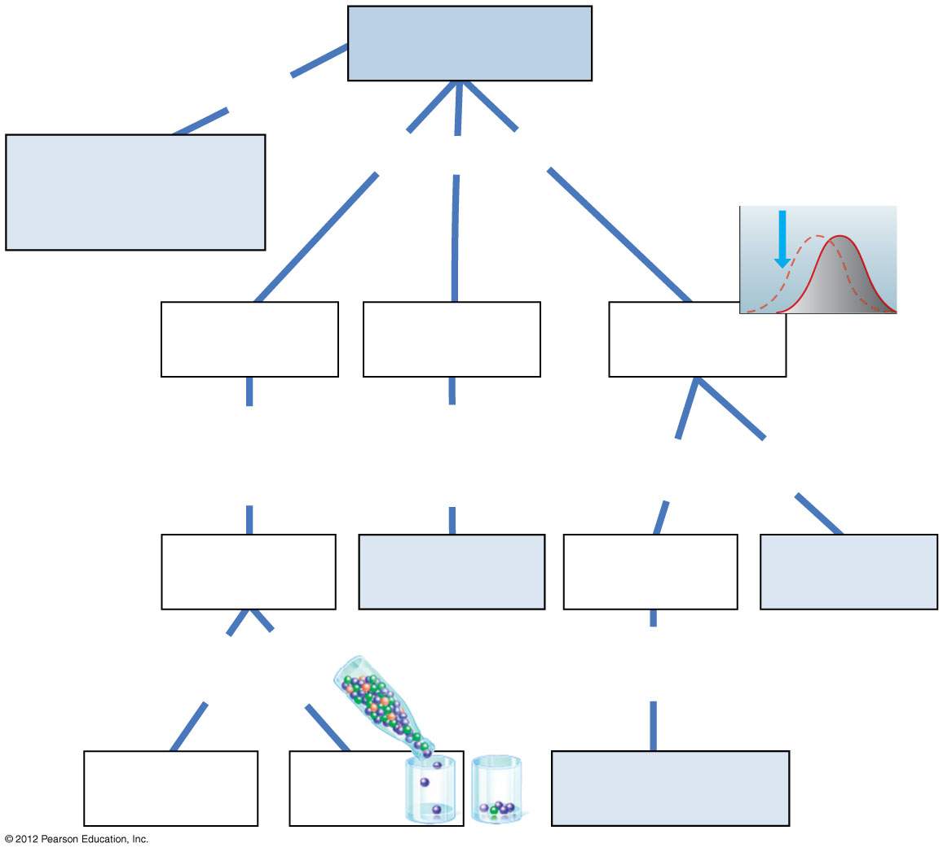
Microevolution
is the
change in allele
frequencies in a
population
may result from
(a)
(b)
(c)
random
fluctuations
more likely in a
due to
movement
of
due
to
leads
to
individuals
or gametes
adaptive
evolution
(d)
(g)
may be
result of
of
individuals
best adapted
to environment
(e)
(f)

